Slide 1


Hand Hygiene Knowledge, Attitudes, and Practices Among Clinical-Year Medical Students in a Kenyan Level 5 Hospital
MERCY CHEPKOECH
MBChB VI
Masinde Muliro University of Science and Technology

Slide 2
Authors
Mercy Chepkoech¹, Kelvin Kipkoech¹, Fredrick Ochieng¹, Anthony Sifuna²
¹Masinde Muliro University of Science and Technology, ²Masinde Muliro University of Science and Technology

Slide 3
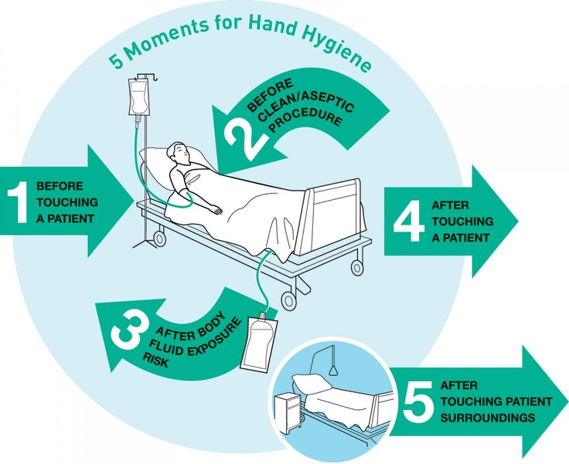

Slide 4
Introduction
Healthcare-associated infections (HCAIs) → major cause of morbidity & mortality
Hand hygiene→ most effective, low-cost method of prevention
Low compliance among healthcare workers remains low
Clinical students frequently provide patient care → potential transmission risk
Role modelling, training, and resource availability influence behaviour

Slide 5
Methods
Design: Cross-sectional study
Setting: Kakamega County General Teaching & Referral Hospital
Period: 3rd–13th July 2025
Participants: 192 clinical year students (Years 3–6)
Sampling: Convenience sampling

Slide 6
Methods
Tool: WHO-adapted online questionnaire (English)
Analysis: Data cleaned in Excel → analyzed in SPSS v29
  Descriptive statistics
  Chi-square tests (p < 0.05)
  Confidence intervals
Ethics: Approval obtained from ISERC; informed consent from participants

Slide 7
Results
Mean age: 22.3 (SD 2.15)
Training received: 65.1% (n = 125, 95% CI 58–71%)

Slide 10
Knowledge
56.3% → correct main route = unclean hands of HCWs
Training improved knowledge (p = .018)
No difference by course (p = .301)

Slide 14
p = .018

Slide 15
Attitudes
93.2% → agreed hand hygiene prevents infections
Only 38.5% strongly agreed curriculum emphasis is adequate

Slide 17
Practices

Slide 20
p < .001

Slide 21
Results
Course of study ↔ knowledge → NS (p = .301)
Gender ↔ practices → NS (p = .599)

Slide 22
Conclusion
Students had moderate knowledge, positive attitudes
Practice compliance remained low
Training and role modelling improved outcomes
Barriers → supplies, time, behaviour

Slide 23
Recommendations
Strengthen hand hygiene teaching in curriculum
Ensure availability of supplies
Senior staff should model compliance
Behaviour change interventions for sustainability

Slide 24

THANK YOU...

